Slide 1

Healthcare Analytics For Doctor Visit TIRTC
Student Name: SANTHOSHA J
College Name: Ballari Institute of Technology and Management
AICTE STU ID: STU6903150a9baac1761809674
GitHub Link: 🔗 View Source Code & Notebook

Slide 2

Problem Statement:
The Doctor Visits dataset contains information about individuals' doctor visits, demographic characteristics, income, illness, health status, chronic conditions, and healthcare coverage.
The objective is to explore the dataset and identify patterns and relationships between these factors and the frequency of doctor visits.
The analysis will focus on understanding how demographic, health-related, and healthcare-access factors are associated with doctor visit patterns.

Slide 3
Project Description:
This project explores the factors associated with doctor visits using Exploratory Data Analysis (EDA). It examines demographic, economic, health, and healthcare coverage variables to identify patterns in healthcare utilisation.
The analysis uses Python-based data cleaning, exploratory data analysis, statistical summaries and visualisations to understand doctor visit frequency and relationships between key variables, providing insights that can support data-driven healthcare decisions.

Slide 4

Who Are The End Users?
Healthcare Providers: Understand patterns in doctor visits and patient healthcare needs.
Healthcare Policymakers: Support healthcare planning and resource allocation.
Insurance Providers: Explore the relationship between insurance coverage and healthcare utilisation.
Public Health Researchers: Study demographic and health-related factors associated with doctor visits.
Healthcare Organisations: Identify trends that can help improve healthcare service planning.

Slide 5

Technology Used:
Python – Programming language used for data analysis
Jupyter Notebook – Environment used to perform and document the analysis
Pandas – Data cleaning, manipulation, and analysis
NumPy – Numerical and statistical operations
Matplotlib – Data visualisation
Seaborn – Statistical and advanced visualisations

Slide 6
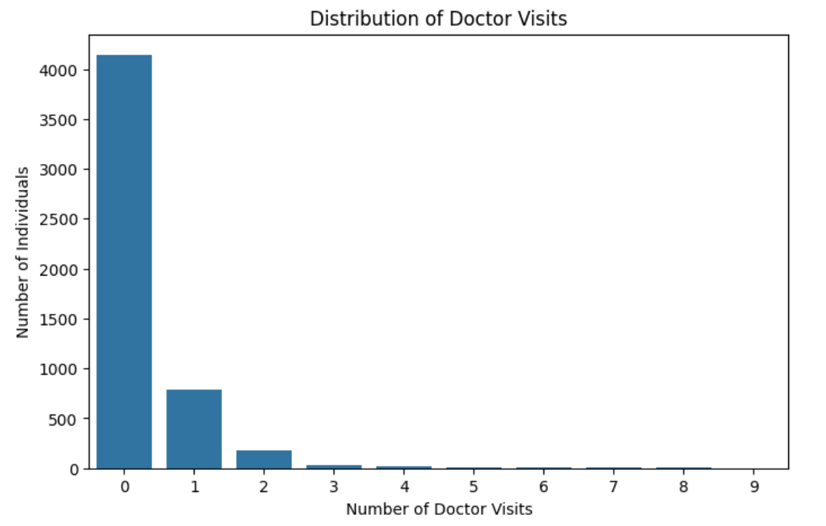
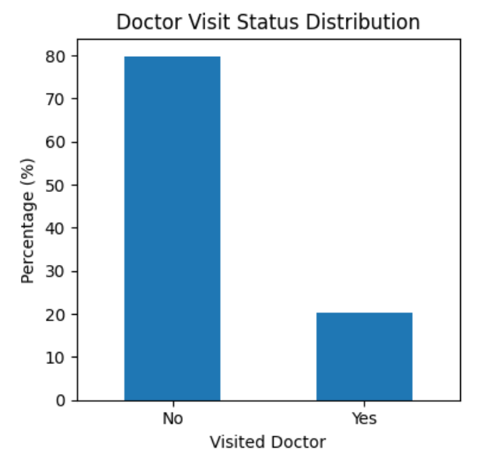
Results - Doctor Visit Patterns
Key Findings:
Approximately 80% of individuals did not visit a doctor, while 20% visited at least once.
Most doctor visits were limited to one or two visits.
The number of individuals decreased sharply as the number of visits increased.
Key Takeaway: Doctor visits were uncommon for most individuals, with healthcare utilisation concentrated among those reporting zero or very few visits.

Slide 7
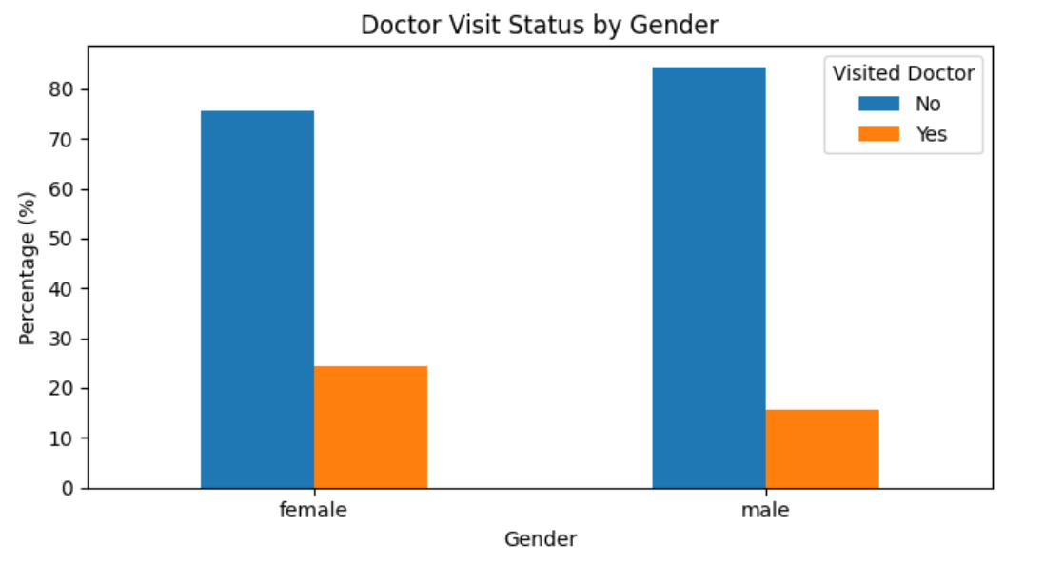
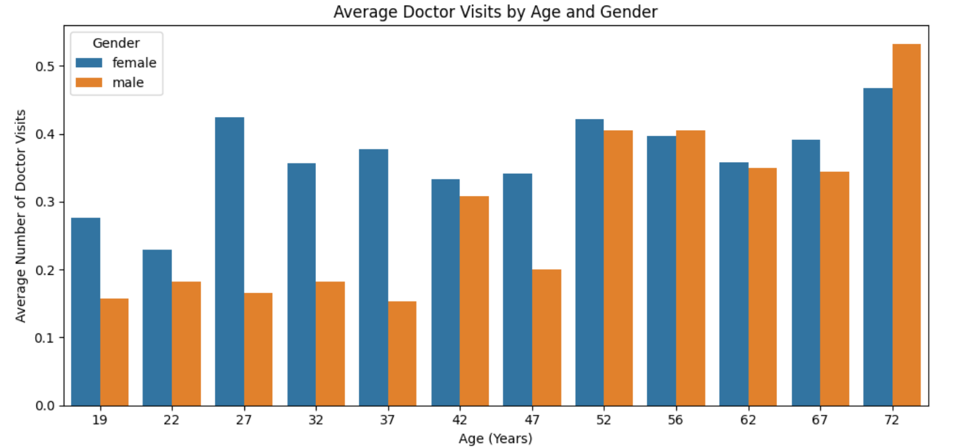
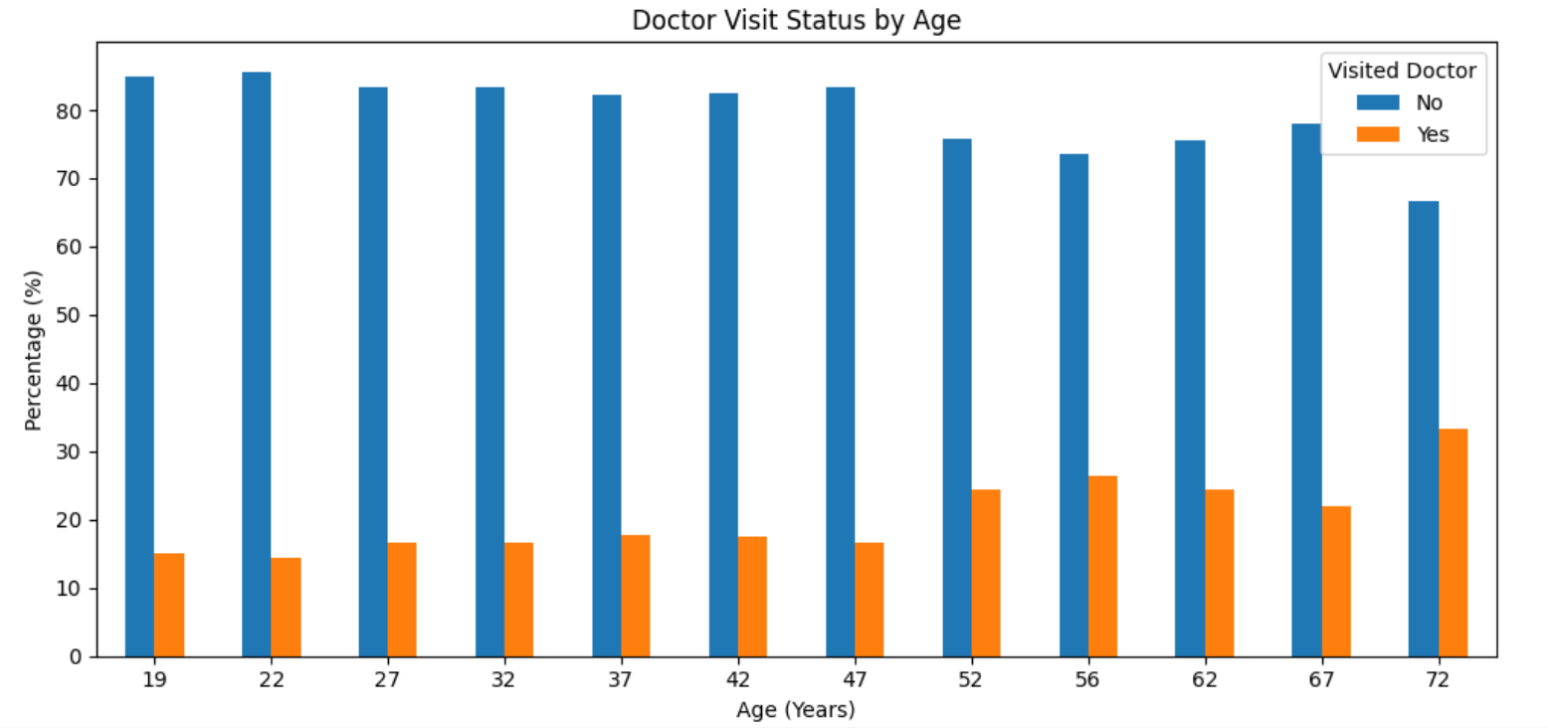
Results - Demographic Factors
Key Findings:
Females were more likely to visit a doctor than males (approximately 24% vs. 16%).
Doctor visit rates generally increased with age, reaching around 33% at age 72.
Females had higher average visits at most younger and middle ages, while males recorded more visits at age 72.
Key Takeaway: Doctor visit patterns varied by age and gender, with older individuals generally showing higher healthcare utilisation.

Slide 8
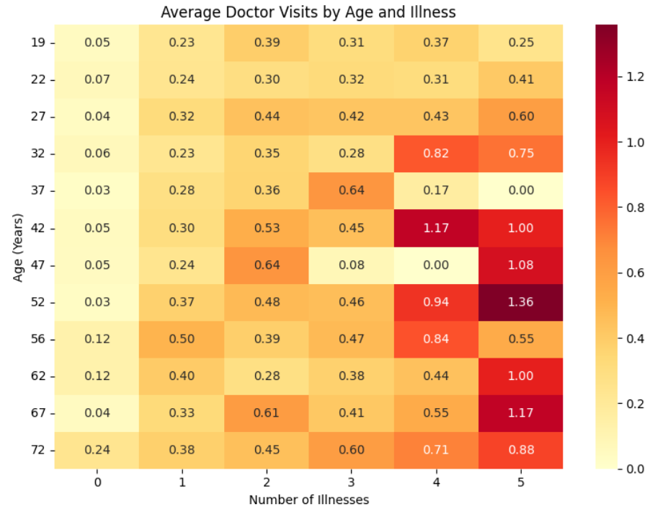
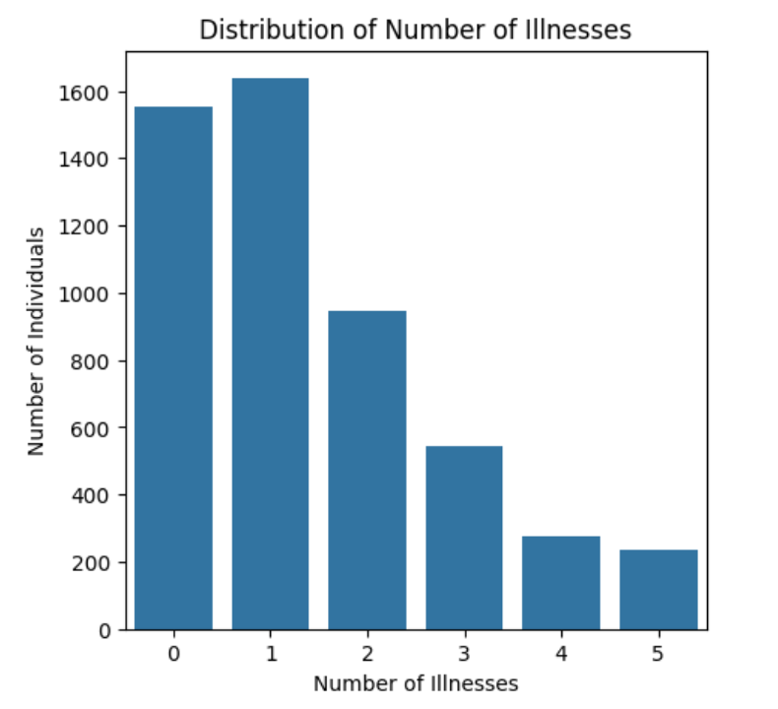
Results - Health and Illness Factors
Key Findings:
Most individuals reported 0–1 illnesses, while fewer reported 3 or more.
Average doctor visits generally increased with illness count, particularly among older individuals.
Individuals aged 42 and 52 with 4–5 illnesses showed relatively high average doctor visits.
Key Takeaway: Higher illness counts were generally associated with more doctor visits, with the pattern varying across age groups.

Slide 9
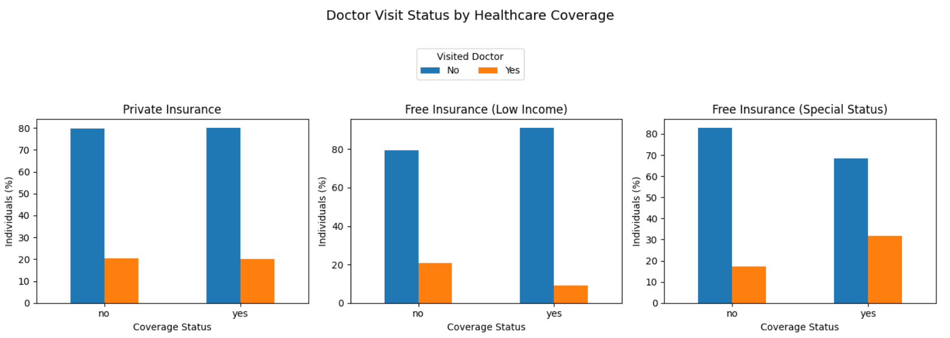
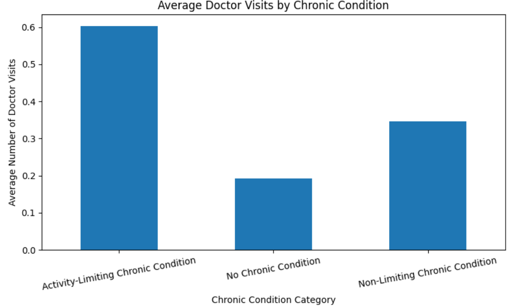
Results - Activity Limitations & Healthcare Coverage
Key Findings:
Individuals with activity-limiting chronic conditions had the highest average doctor visits (0.60).
Private insurance coverage showed little difference in doctor visit rates between covered and uncovered individuals.
Individuals with special-status free insurance had a higher doctor visit rate (about 32%) than those without it (about 18%).
Key Takeaway: Chronic conditions limiting activity and certain healthcare coverage categories were associated with higher doctor visit rates.

Slide 10
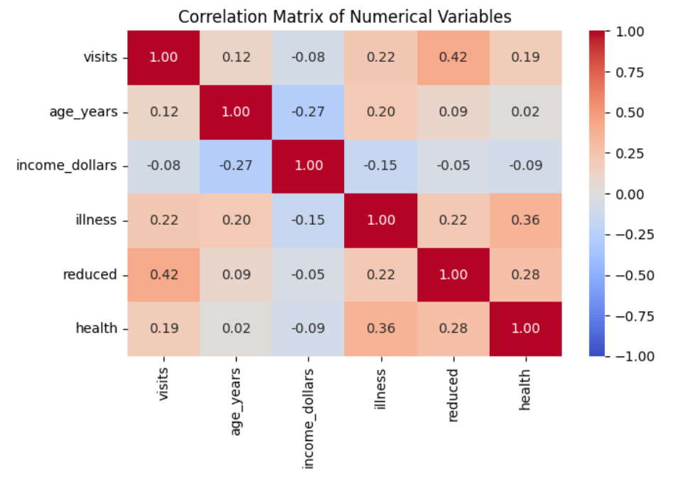
Results - Key Relationships
Key Findings:
reduced had the strongest positive correlation with doctor visits (0.42).
illness showed a positive correlation with doctor visits (0.22), while health had a weaker positive correlation (0.19).
age_years showed a weak positive correlation (0.12), while income_dollars showed a weak negative correlation (−0.08).
Key Takeaway: Reduced activity and illness count showed stronger positive associations with doctor visits than age or income.

Slide 11
Thank you
.
.

